Slide 1
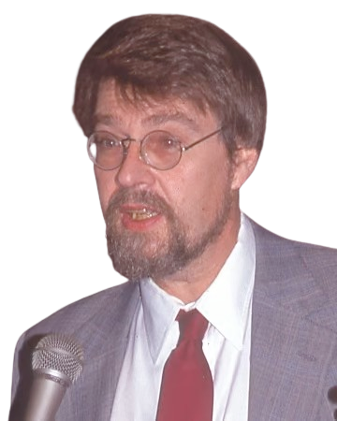
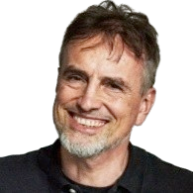

DL4Med (BMSC-GA 4493, BMIN-GA 3007) - Lab 6 - Recurrent Neural Networks
He discovered this presentation!

Slide 2
Dataset:
We’ll use a toy dataset, the actual one will be used in HW3.
The goal today is to familiarise with implementations and intuition.
Implementations will be pure PyTorch for easier tracability, but in HW3 you would be better off using existing modules (e.g. torch.nn.RNN). We’ll be moving over between presentation and notebook.

Slide 3
Important Resources:
General:
I owe a sizable chunk of my expertise to reading through Phil Wang’s (lucidrains) repos.
The rest of it is Yannic Kilcher’s videos and Discord.
For today:
Madsen et al., Distill
Chris Olah’s blog
Jay Alammar’s blog
Tom Yeh’s Excel RNN - More Excel to come, indubitably the most powerful programming framework.
“The AI Hacker”’s video

Slide 4
Formatting:
Notation (Math)
Intuition (Motivation, Expected outcome)
Implementation (Have your Colab/session ready)

Slide 5
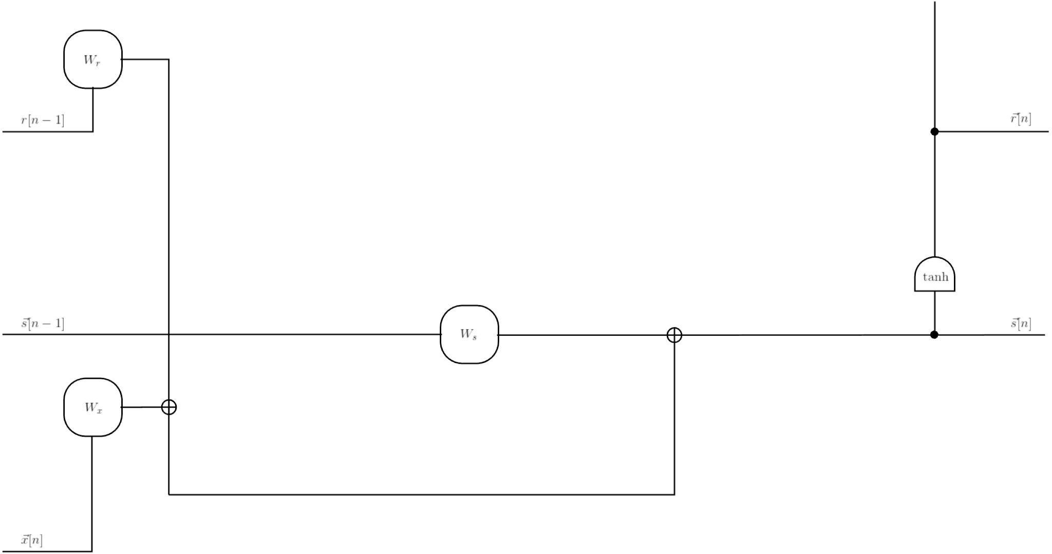
Example (RNNs): Notation
Sherstinsky, Physica D, 2020

Slide 6
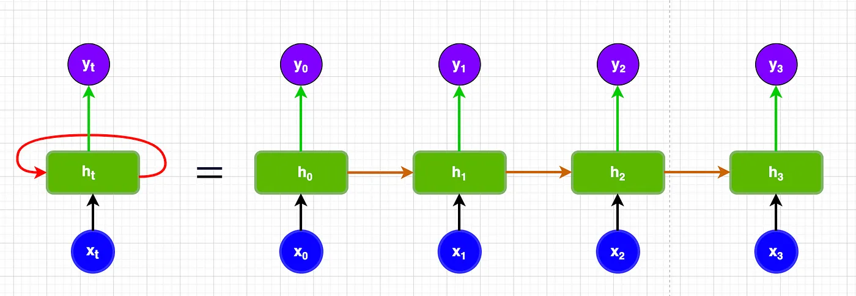
Example (RNNs): Intuition
Sherstinsky, Physica D, 2020

Slide 7
Example (RNNs): Implementation
Spro, Practical Pytorch, GitHub

Slide 8
Issues with RNNs: Examining exploding gradients
Smerity.com

Slide 9
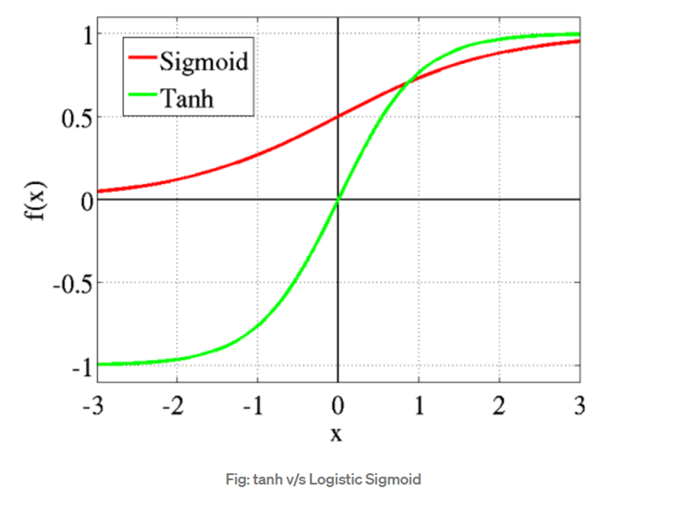
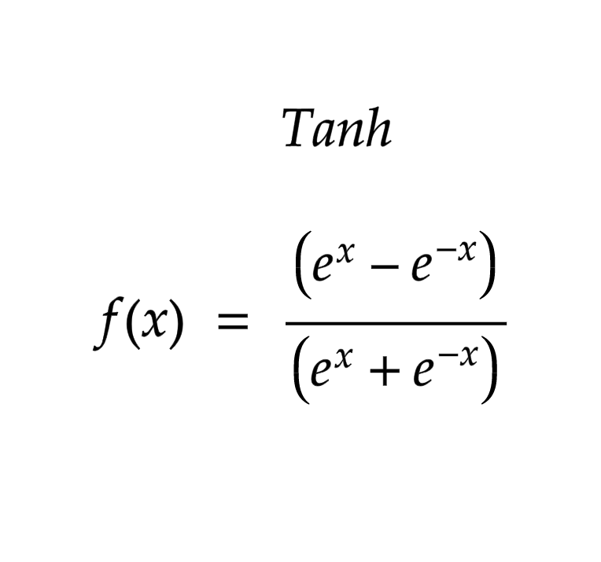
Tanh? What even is that?

Slide 10
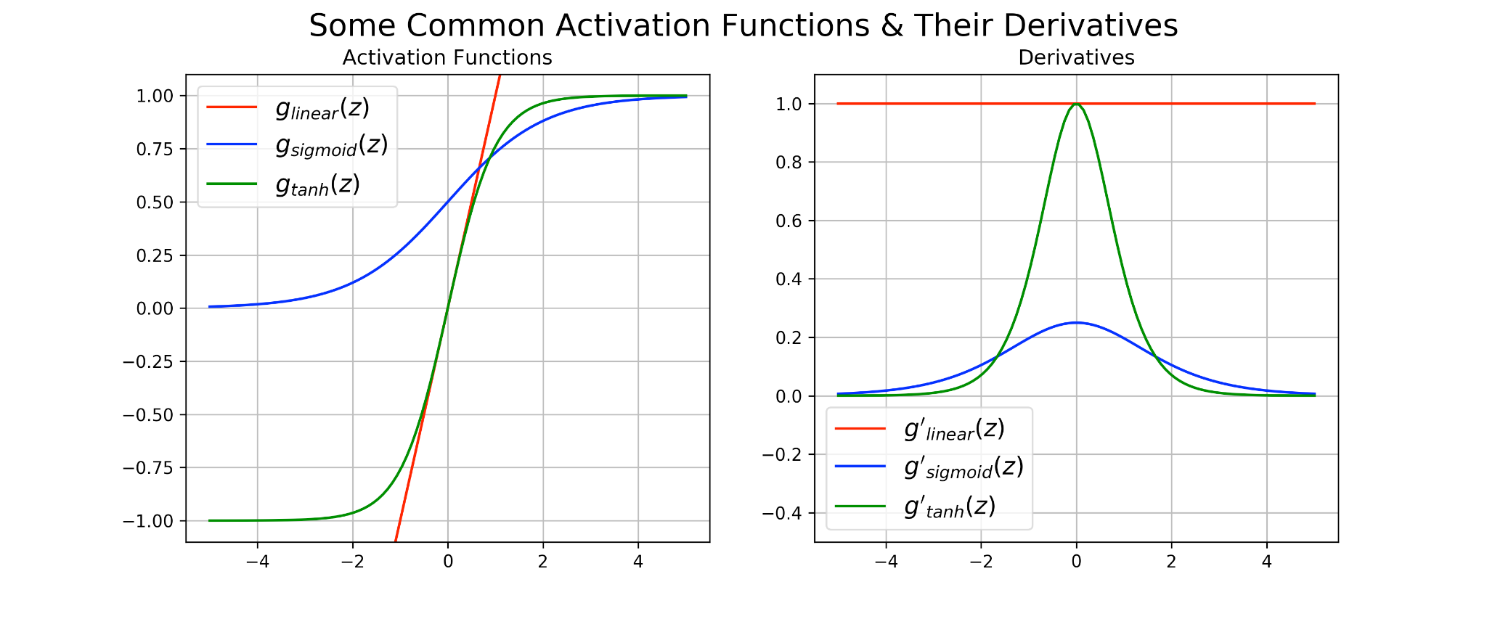
Sure, but why?
Centered on zero.
-1, +1 bound - No exploding activation
Cool derivative properties (rate of rate of change is low - stability - curvature)
Disadvantages:
Large inputs have 0 gradients.

Slide 11
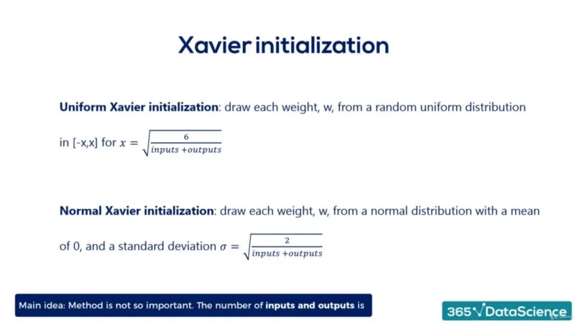
Iterating on the architecture - Weight initialization
Glorot, MLR, 2010
Saurav Maheshkar, WandB

Slide 12
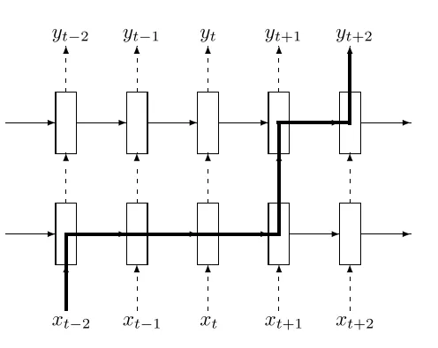
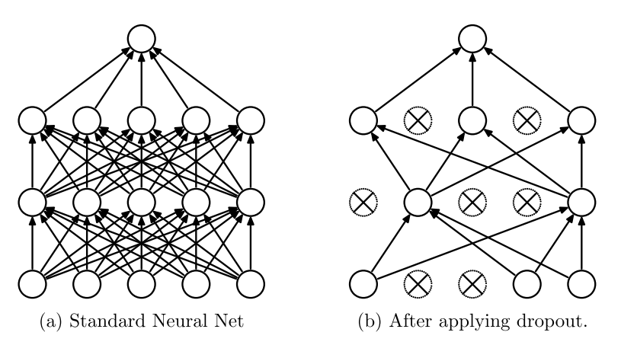
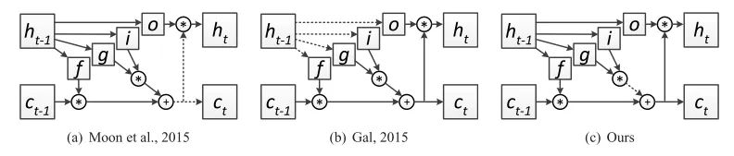
Dropout
Non-recurrent dropout
Adrian G, Medium
Zaremba et al., 2014,
Gal & Ghamarani, 2015
Semeniuta et al., 2016

Slide 13
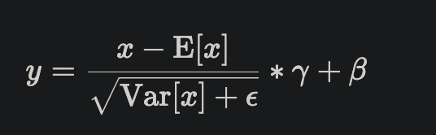
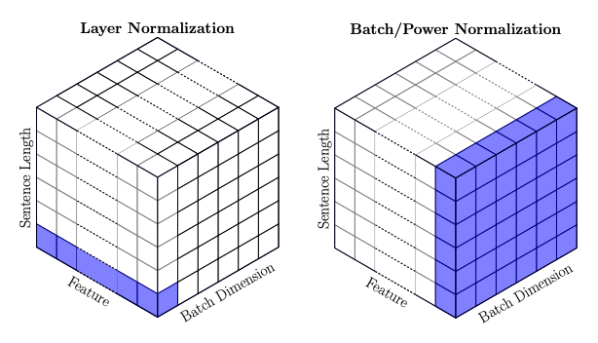
Layer Normalization
Ba et al., 2016,
Xu et al., 2019,
Pytorch docs

Slide 14
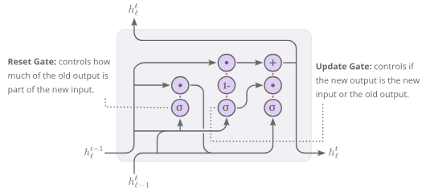
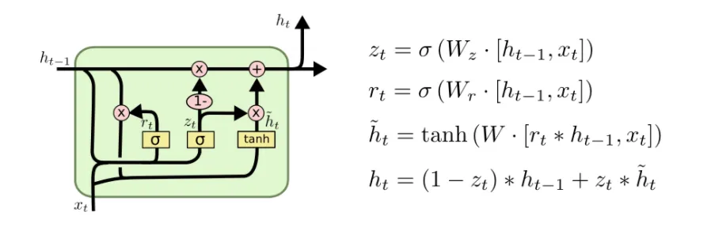
GRU: Notation
Sherstinsky, Physica D, 2020

Slide 15
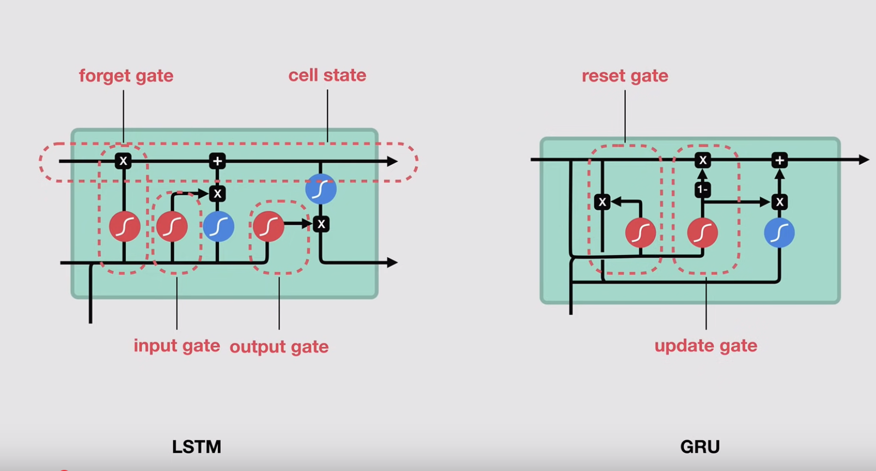
GRU: Intuition
Sherstinsky, Physica D, 2020

Slide 16
GRU: Implementation
Sherstinsky, Physica D, 2020

Slide 17
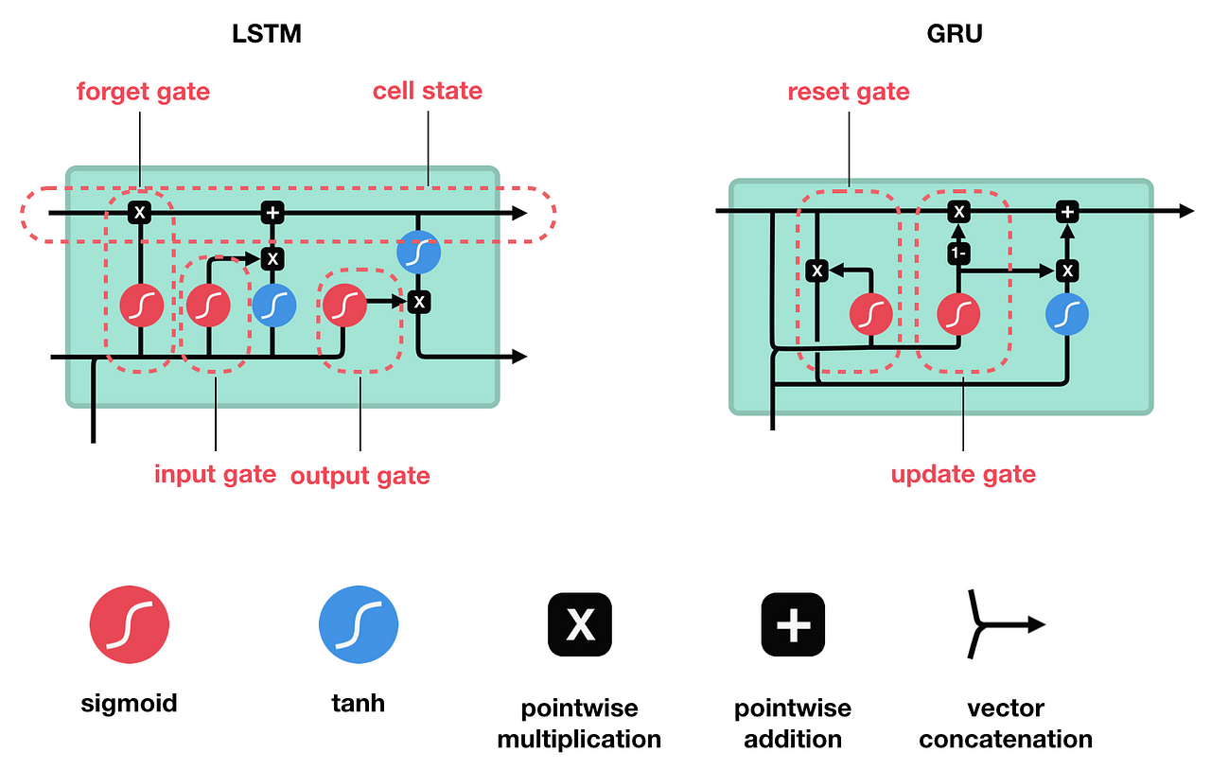
LSTM: Intuition
Sherstinsky, Physica D, 2020,
Christopher Olah (Colah)
Hochreiter & Schmidhuber, 1997, NeuComp

Slide 18
LSTM: Implementation
Sherstinsky, Physica D, 2020

Slide 19
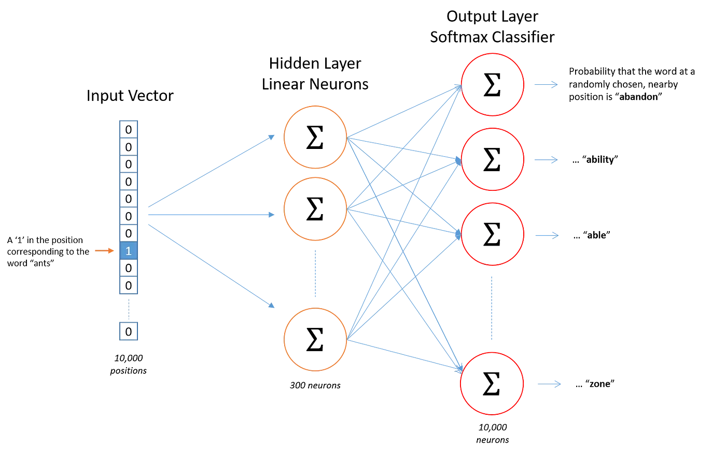
But these aren’t words! (or other kinds of sequences)
Collis, Medium
https://ronxin.github.io/wevi/

Slide 20
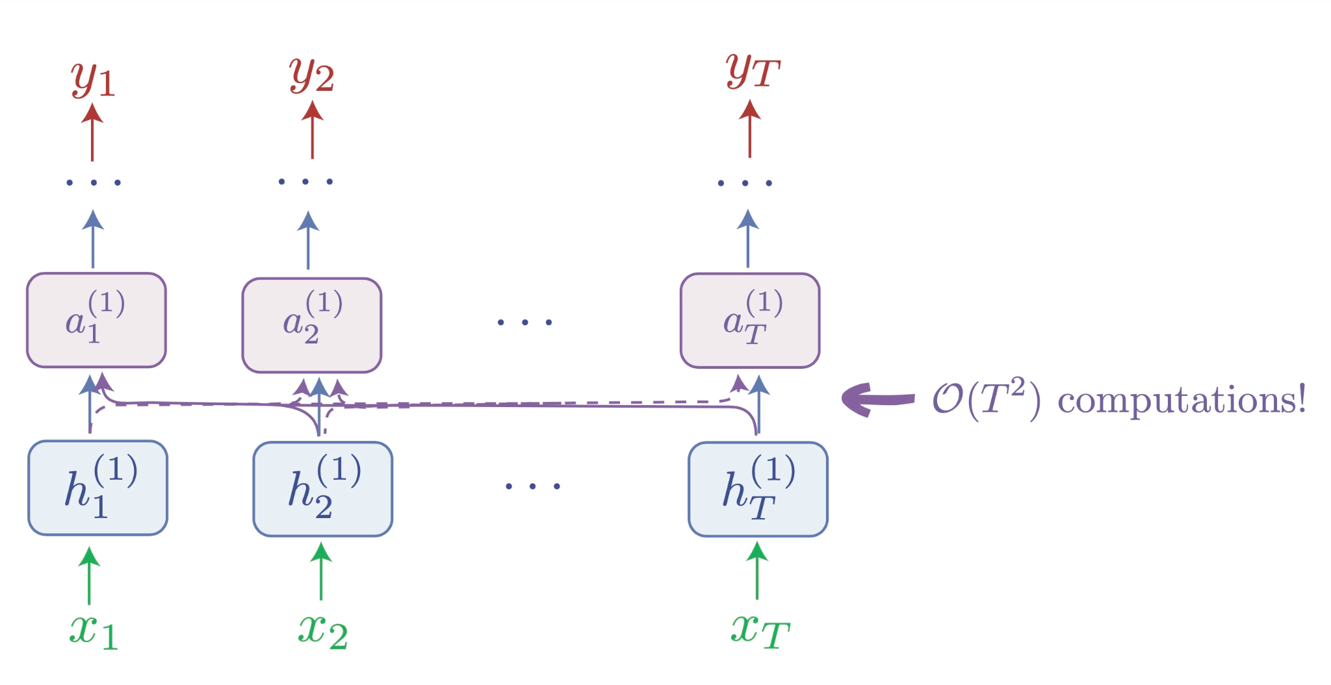
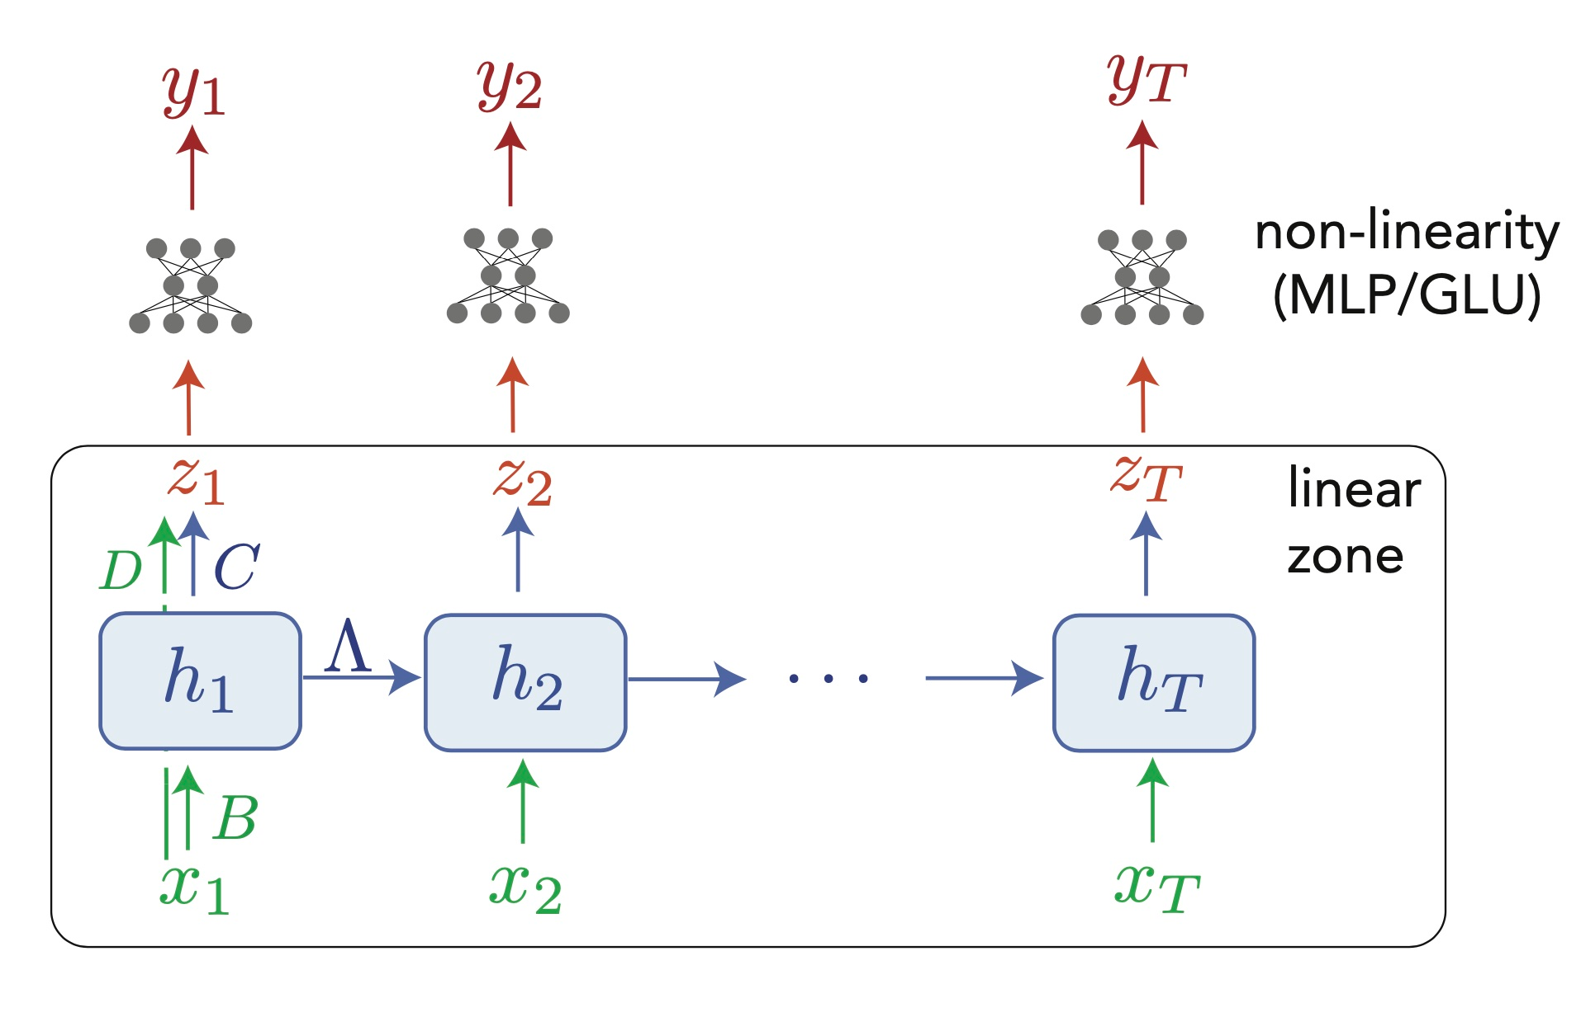
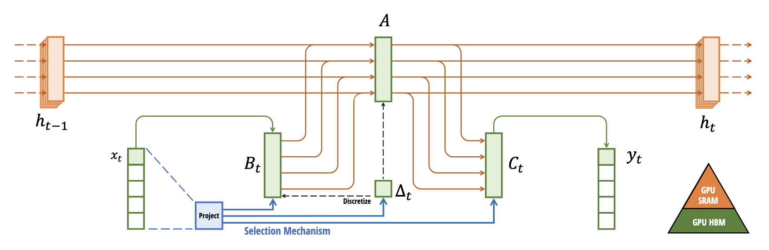
Dead technology?
Peng, Alcaide, Anthony
Feng et al., 2024
Orvieto et al., 2023
Gu and Tridao, 2024

Slide 21
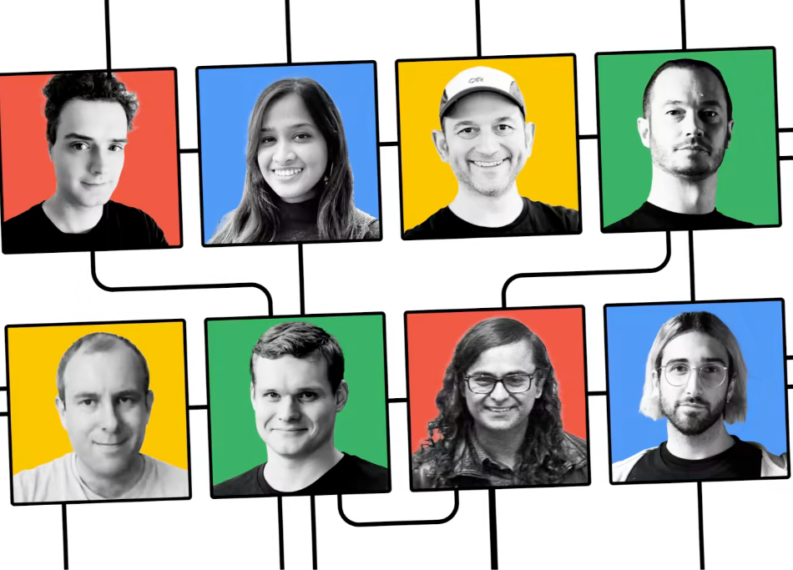
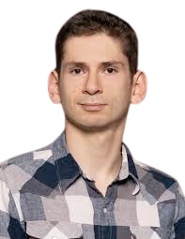
If I was able to reach here, we got further than expected.
Bahdanau et al., 2016 → Same Cho and Bengio from GRU
Vaswani et al.***, 2017

Slide 22
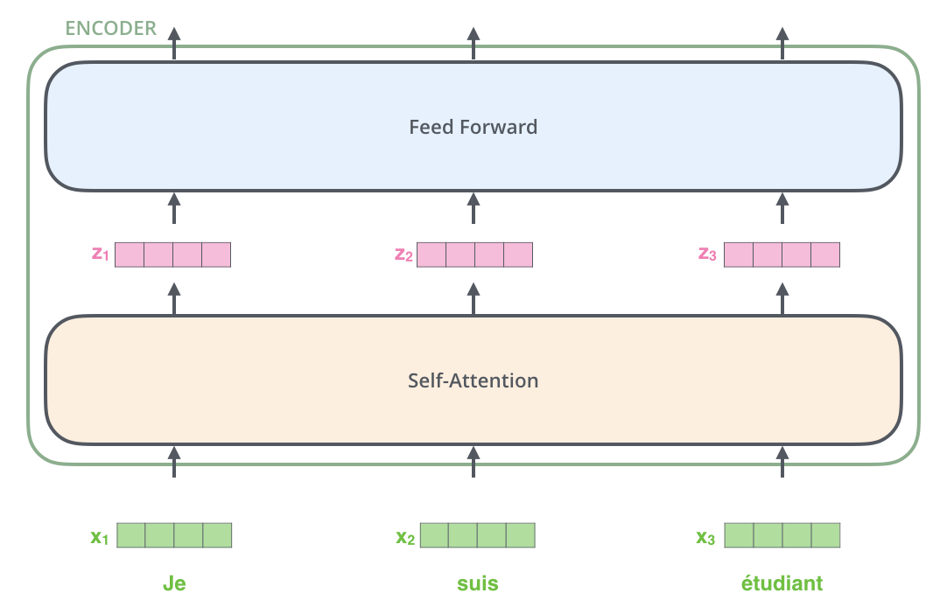
Beginning neural machine translation (This is simply Jay Alammar’s blog)

Slide 23
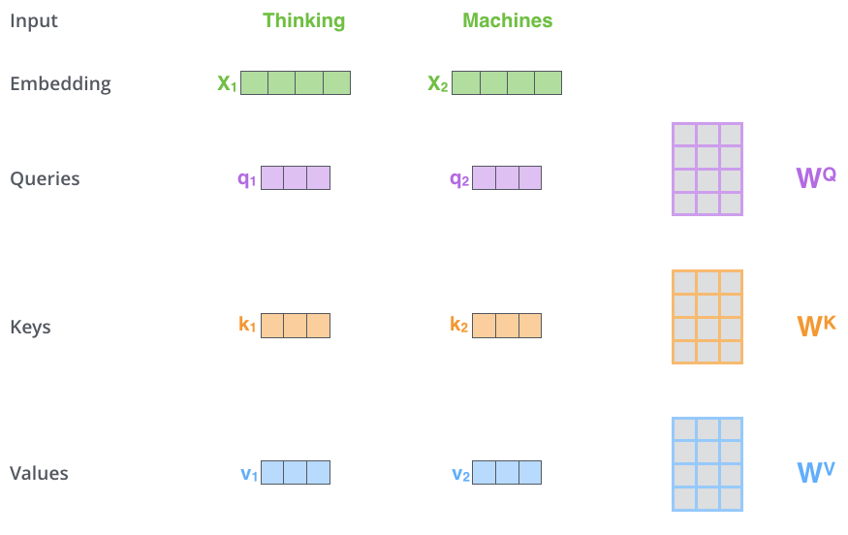
Q, K, V

Slide 24
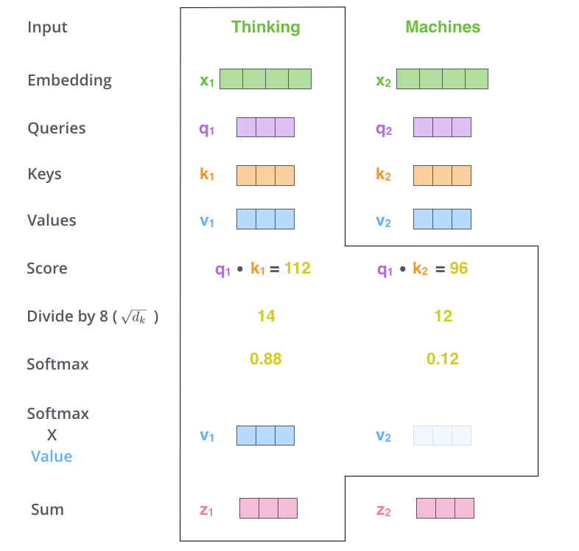
Q, K, V (2)

Slide 25
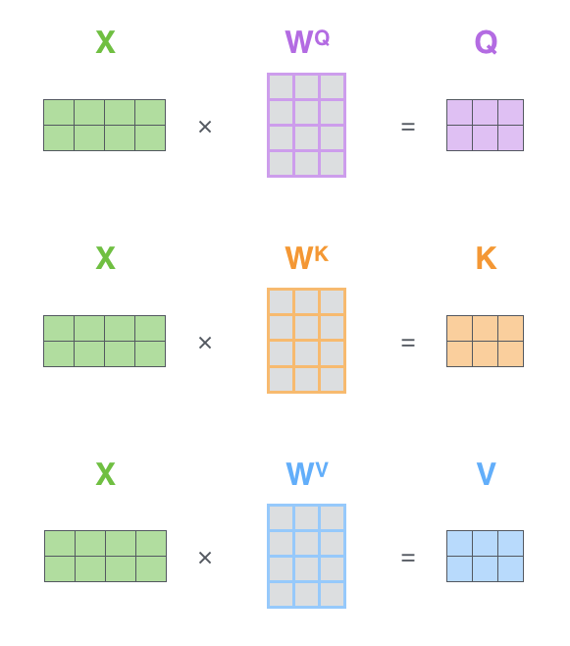
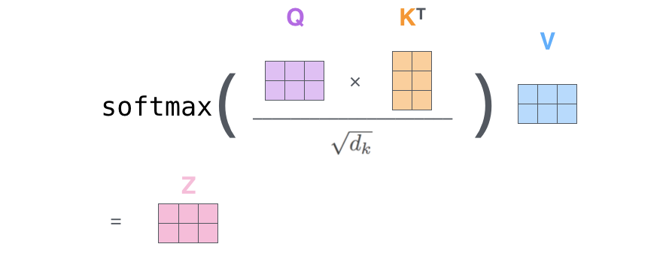
Q, K, V (3)

Slide 26
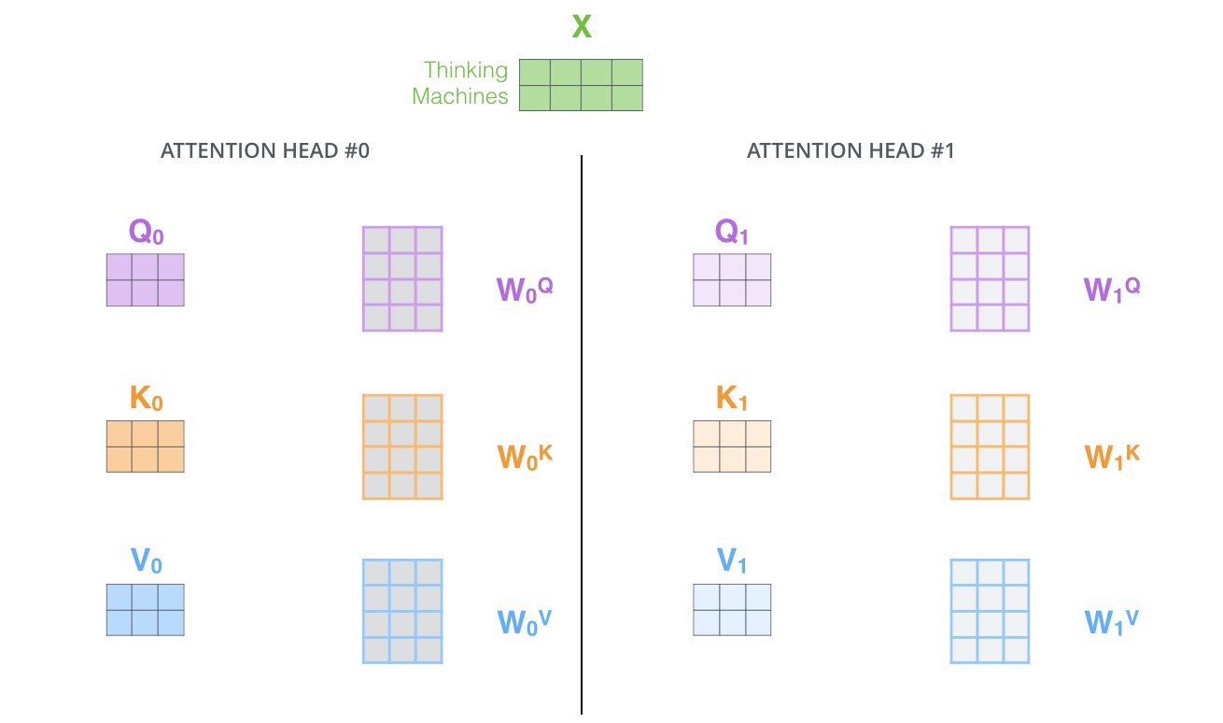
Multi-head attention

Slide 27
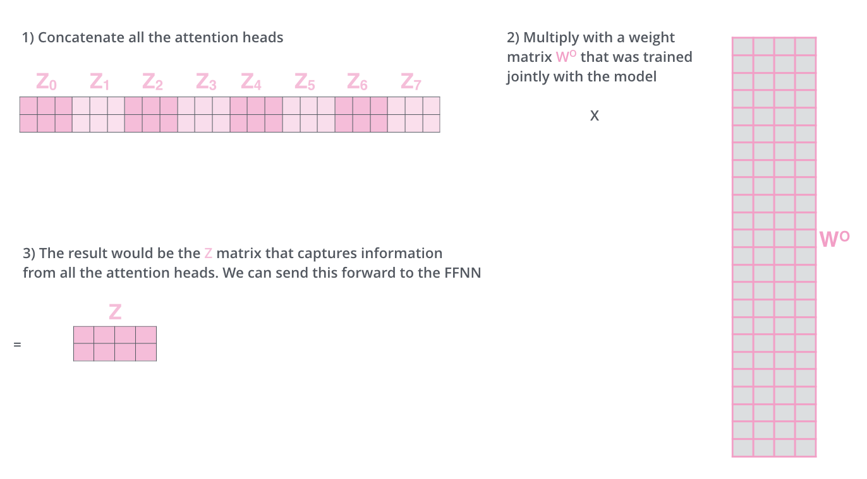
Multi-head attention (2)

Slide 28
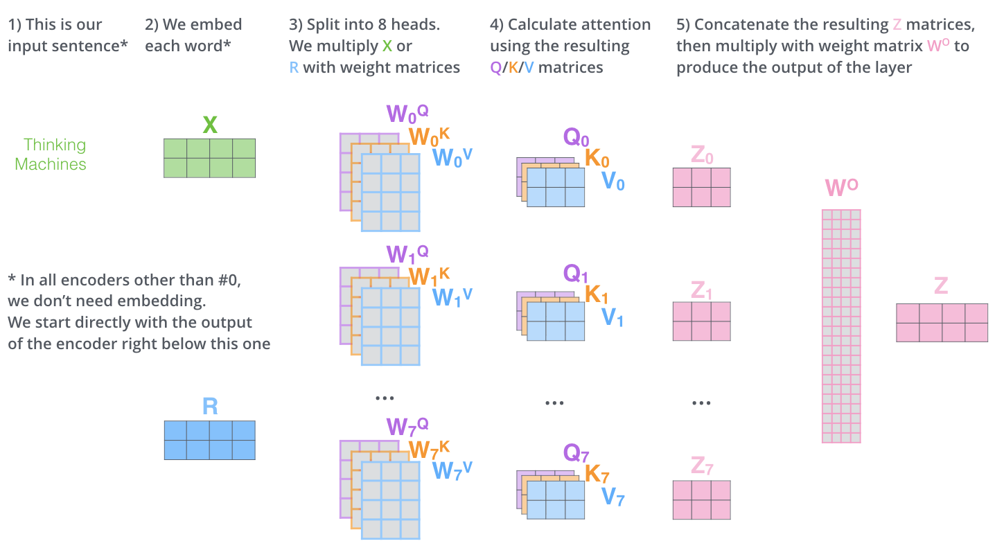
Putting it all together

Slide 29
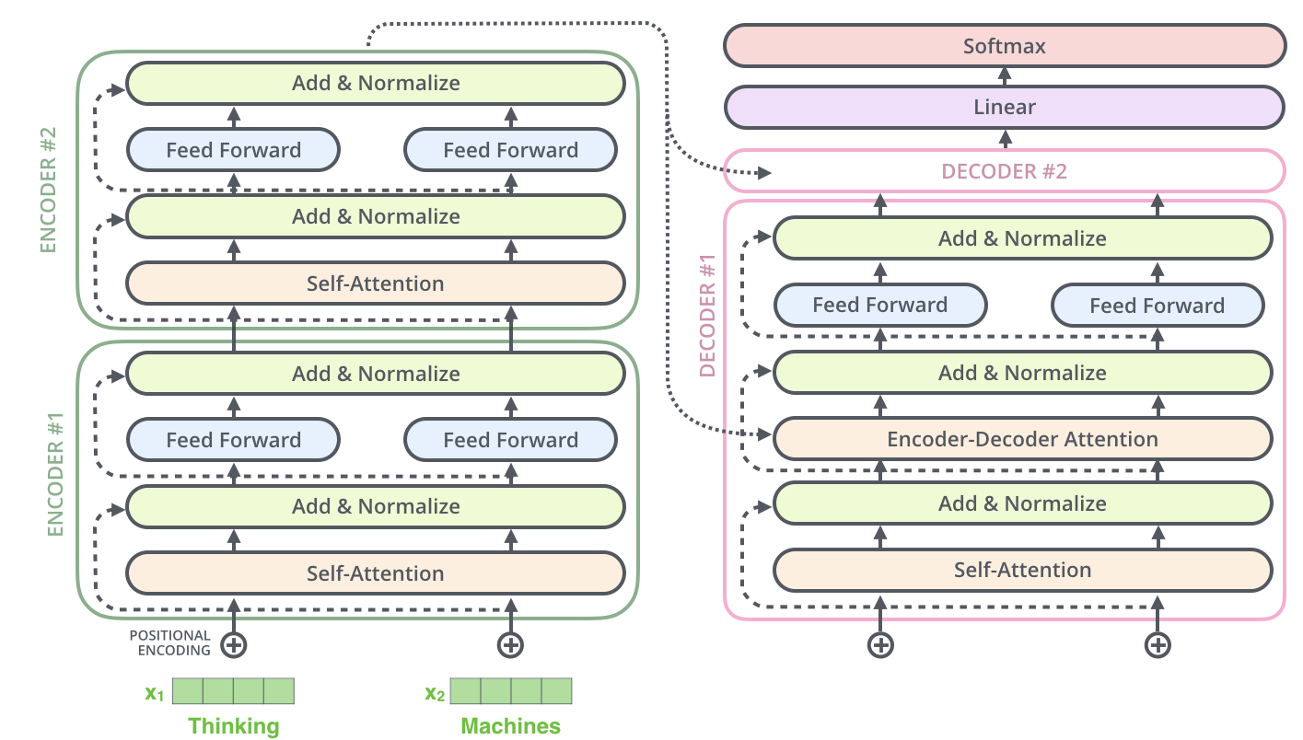
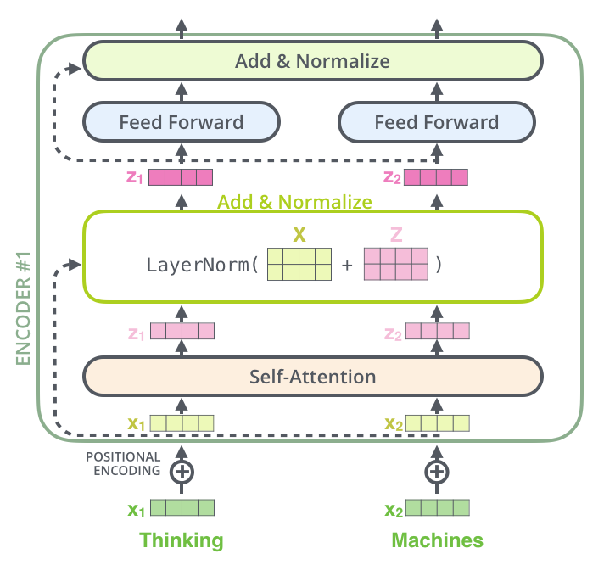
Extra parts: Residuals, positional encodings, LayerNorm

Slide 30
Transformer: Implementation

